Slide 1
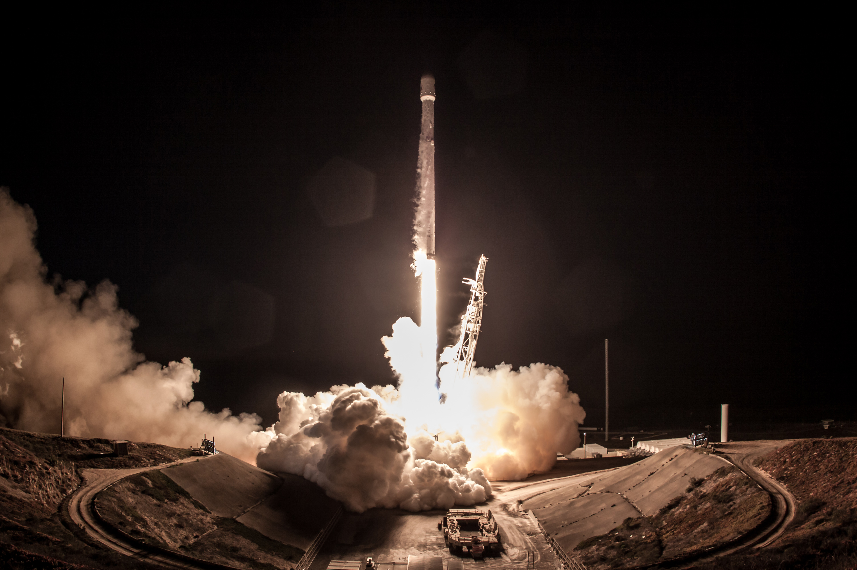
DATA SCIENCE CAPSTONE
Den Bych
30.05.2023

Slide 2
Outline
Executive Summary
Introduction
Methodology
Results
Conclusion
Appendix

Slide 3
Executive Summary
Summary of methdologies:
Data collection
Data wrangling
Exploratory Data Analysis with Data Visualization
Exploratory Data Analysis with SQL
Building an interactive map with Folium
Building a Dashboard with Plotly Dash
Predictive analysis (Classification)
Summary of results:
Exploratory Data Analysis results
Interactive Visual Analytics
Prediction Analysis

Slide 4
Introduction
In this capstone, we will predict if the Falcon 9 first stage will land successfully. SpaceX advertises Falcon 9 rocket launches on its website with a cost of 62 million dollars; other providers cost upward of 165 million dollars each, much of the savings is because SpaceX can reuse the first stage. Therefore if we can determine if the first stage will land, we can determine the cost of a launch. This information can be used if an alternate company wants to bid against SpaceX for a rocket launch. We are going to analyze public information and determine which landing is success and which are not. We will use exploratory, visual and predictive analysis for this purpose.
What influences a successful landing? What are the rocket and environmental requirements?

Slide 5
Methodology
All steps of project:
Data Collection and Wrangling(sources: SpaceX API, Web Scraping from the Wikipedia)
Exploratory Data Analysis(EDA), using:
SQL
Pandas
Data Visualization, using:
Matpoltlib and Seaborn
Folium
Dash
Machine learning, using:
Logistic regression
SVM
Decision Tree
KNN

Slide 6
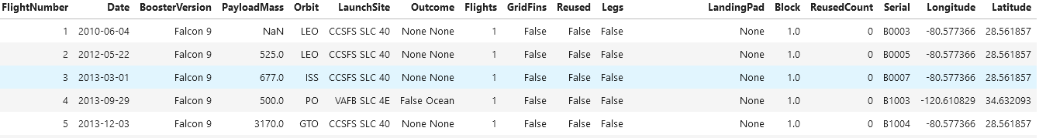
Data Collection – SpaceX API
One way to collect data is to use the SpaceX API. Like this: https://api.spacexdata.com/v4/rockets/
Data are filtered to include only Falcon 9 rockets. Missing values are replaced by the mean of the corresponding column.

Slide 7
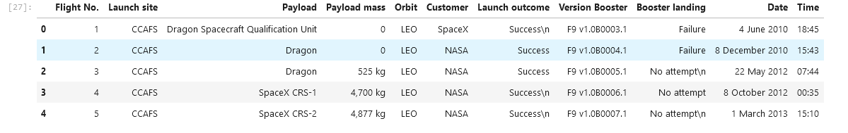
Data Collection - Scraping
Another way is web scraping from different websites. We will use this link now: https://en.wikipedia.org/wiki/List_of_Falcon_9_and_Falcon_Heavy_launches?utm_id=NA-SkillsNetwork-Channel-SkillsNetworkCoursesIBMDS0321ENSkillsNetwork26802033-2022-01-01
Data contain only Falcon 9 launches.

Slide 8
Data Wrangling
At this stage we try to understand what we have and what we will do with the data. We are introduced to the data set and its characteristics.
How do we analyze the data and create a new feature such as Class to understand what is a successful landing or not.

Slide 9
EDA with SQL
Performed SQL queries: • Displaying the names of the unique launch sites in the space mission • Displaying 5 records where launch sites begin with the string ‘CCA' • Displaying the total payload mass carried by boosters launched by NASA (CRS) • Displaying average payload mass carried by booster version F9 v1.1 • Listing the date when the first successful landing outcome in ground pad was achieved • Listing the names of the boosters which have success in drone ship and have payload mass greater than 4000 but less than 6000 • Listing the total number of successful and failure mission outcomes • Listing the names of the booster versions which have carried the maximum payload mass • List the records which will display the month names, failure landing_outcomes in drone ship ,booster versions, launch_site for the months in year 2015
• Rank the count of successful landing_outcomes between the date 04-06-2010 and 20-03-2017 in descending order

Slide 10
EDA with Data Visualization
Charts were plotted: Flight Number vs. Payload Mass, Flight Number vs. Launch Site, Payload Mass vs. Launch Site, Orbit Type vs. Success Rate, Flight Number vs. Orbit Type, Payload Mass vs Orbit Type and Success Rate Yearly Trend. Scatter plots show the relationship between variables. If a relationship exists and has a good correlation, it could be used in a machine learning model.
Bar charts show comparisons between discrete categories. The aim is to show the relationship between the specific categories being compared and a measured value.
Line charts show trends in data over time (time series).

Slide 11
Build an Interactive Map with Folium
Added circle, pop-up and text markers for all launch pads with their latitude and longitude coordinates to show their geographic location and proximity to the equator and coastline.
Coloured markers for successful (green) and unsuccessful (red) launches have been added using a cluster of markers to identify which launch pads have a relatively high success rate.
Coloured lines have been added to show the distances between launch sites and their immediate surroundings, such as railways, highways, coastlines and the nearest town.

Slide 12
Build a Dashboard with Plotly Dash
Added a dropdown list to the Launch Site selection.
Added a pie chart to show the total number of successful launches for all sites and the number of successes vs. failures for the site when a specific launch site has been selected.
Added a slider to select the payload range.
Added a scatter plot to show the correlation between payload and launch success.

Slide 13
Predictive Analysis (Classification)
The scikit-learn library is used to develop predictive models, evaluate them, select the best and preprocess the data.
In this step used:
Data standardization
Creation of a training and test set from the original data set
Building and comparing logistic regression, SVM, decision tree and KNN models

Slide 14
Results
The results are divided into 4 parts:
Exploratory data analysis results(with plots and maps and SQL queries)
Interactive analytics demo in screenshots(dashboard)
Predictive analysis results(4 predictive models)

Slide 15
EDA VIA VISUALIZATION

Slide 16
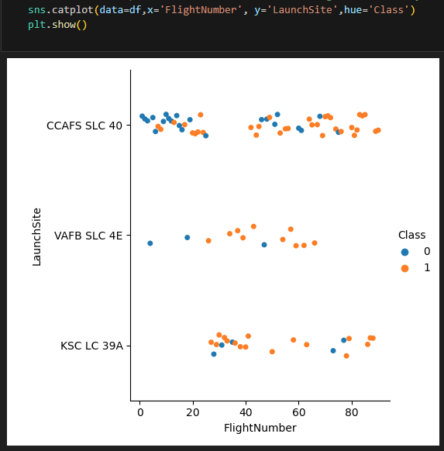
Flight Number vs. Launch Site
Explanation:
As the number of launches increases, so does the likelihood of success.
CCAFS SLC 40 is the most popular Launch Site

Slide 17
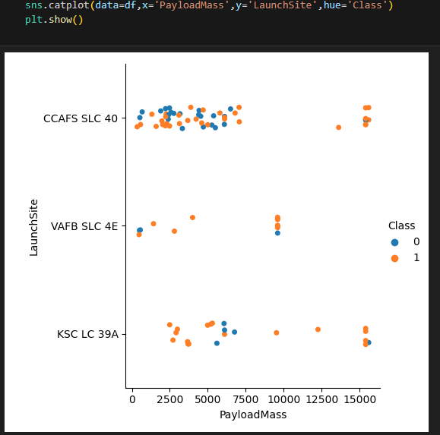
Payload vs. Launch Site
Explanation:
Now if you observe Payload Vs. Launch Site scatter point chart you will find for the VAFB-SLC launchsite there are no rockets launched for heavypayload mass(greater than 10000).
CCAFS SLC 40 is good choice for extra heavy rockets(>10000)
KSC LC 39A has 100% success rate for payload mass under 5000

Slide 18
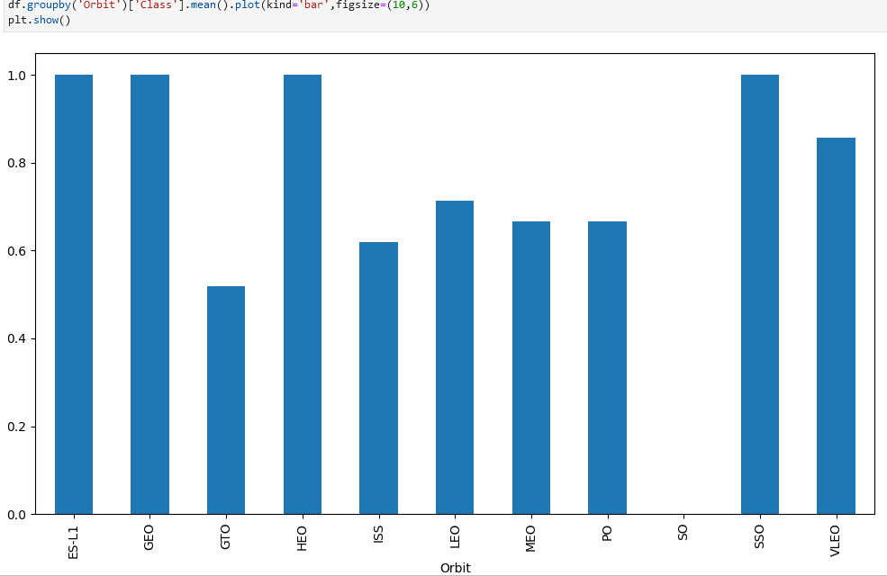
Success Rate vs. Orbit Type
Explanation:
The ES-L1, GEO, HEO,SSO has 100% success rate
The SO orbit has 0% rate, but it was just one launch

Slide 19
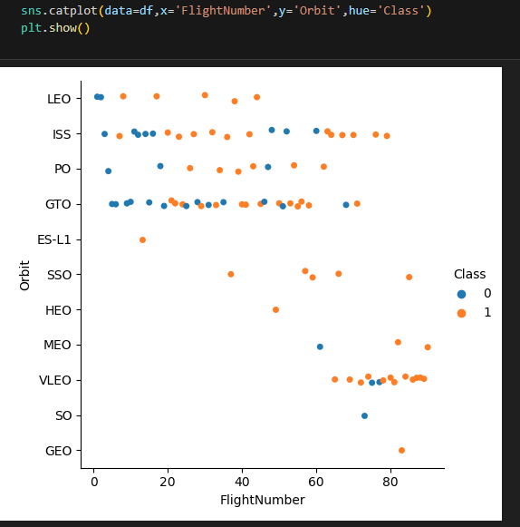
Flight Number vs. Orbit Type
Explanation:
The LEO orbit the Success appears related to the number of flights; on the other hand, there seems to be no relationship between flight number when in GTO orbit.

Slide 20
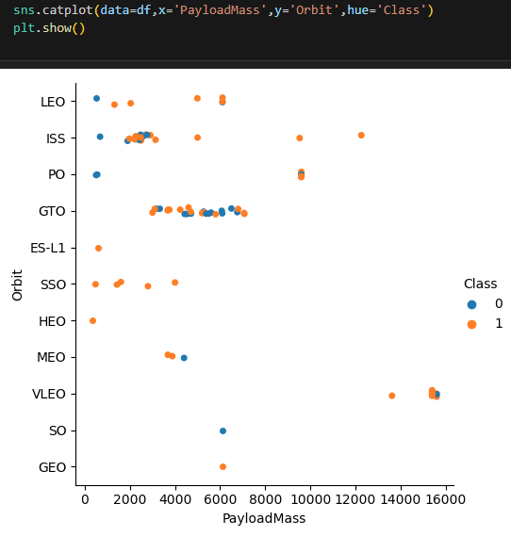
Payload vs. Orbit Type
Explanation:
With heavy payloads the successful landing or positive landing rate are more for Polar,LEO and ISS.However for GTO we cannot distinguish this well as both positive landing rate and negative landing(unsuccessful mission) are both there here.

Slide 21
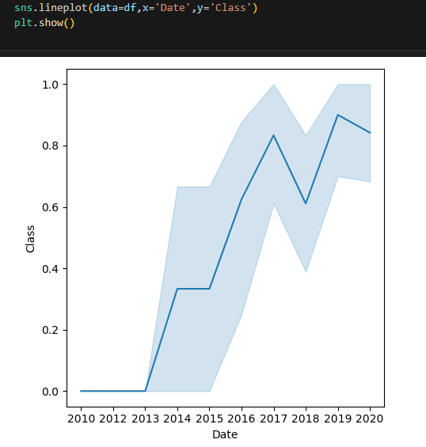
Launch Success Yearly Trend
Explanation:
The success rate since 2013 kept increasing till 2020.

Slide 22
EDA with SQL

Slide 23
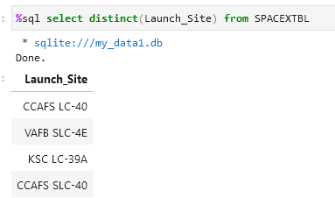
All Launch Site Names
Explanation:
All unique launch site names.

Slide 24
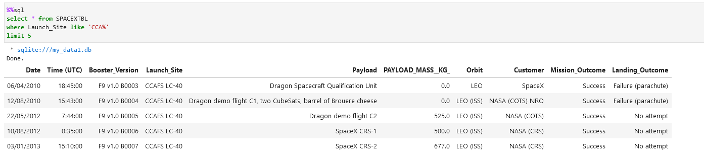
Launch Site Names Begin with 'CCA'
Explanation:
Displaying 5 records where launch sites begin with the string 'CCA'.

Slide 25
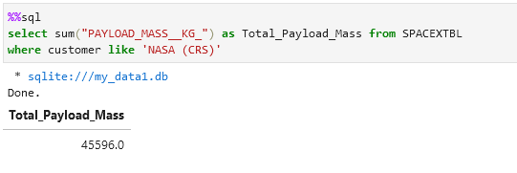
Total Payload Mass
Explanation:
Display of the total payload mass carried by boosters launched by NASA (CRS)

Slide 26
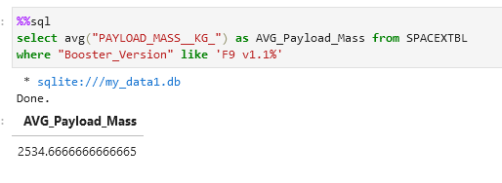
Average Payload Mass by F9 v1.1
Explanation:
Display of the average payload mass carried by booster version F9 v1.1

Slide 27
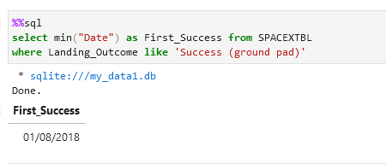
First Successful Ground Landing Date
Explanation:
The date when the first succesful landing outcome in ground pad was acheived.

Slide 28
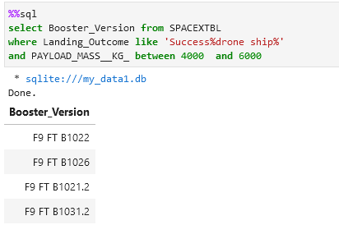
Successful Drone Ship Landing with Payload between 4000 and 6000
Explanation:
List of the names of the boosters which have success in drone ship and have payload mass greater than 4000 but less than 6000

Slide 29
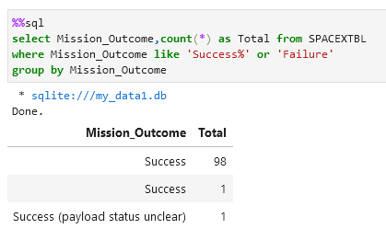
Total Number of Successful and Failure Mission Outcomes
Explanation:
List of the total number of successful and failure mission outcomes

Slide 30
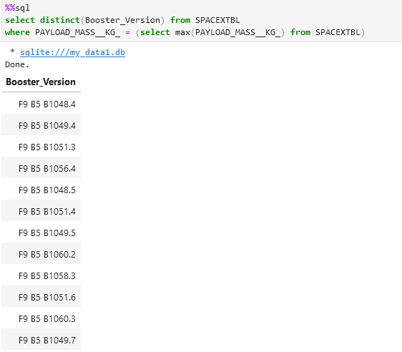
Boosters Carried Maximum Payload
Explanation:
List of the names of the booster which have carried the maximum payload mass

Slide 31
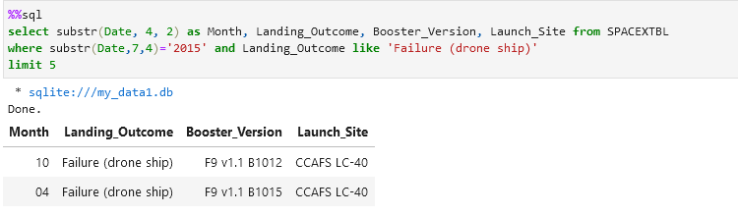
2015 Launch Records
Explanation:
List of the failed landing_outcomes in drone ship, their booster versions, and launch site names for in year 2015

Slide 32
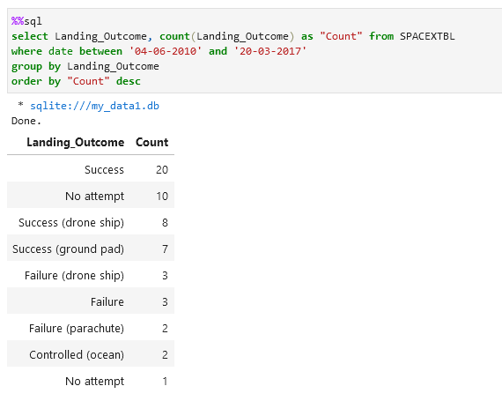
Rank Landing Outcomes Between 2010-06-04 and 2017-03-20
Explanation:
Rank the count of landing outcomes (such as Failure (drone ship) or Success (ground pad)) between the date 2010-06-04 and 2017-03-20, in descending order

Slide 33
Interactive map with Folium

Slide 34
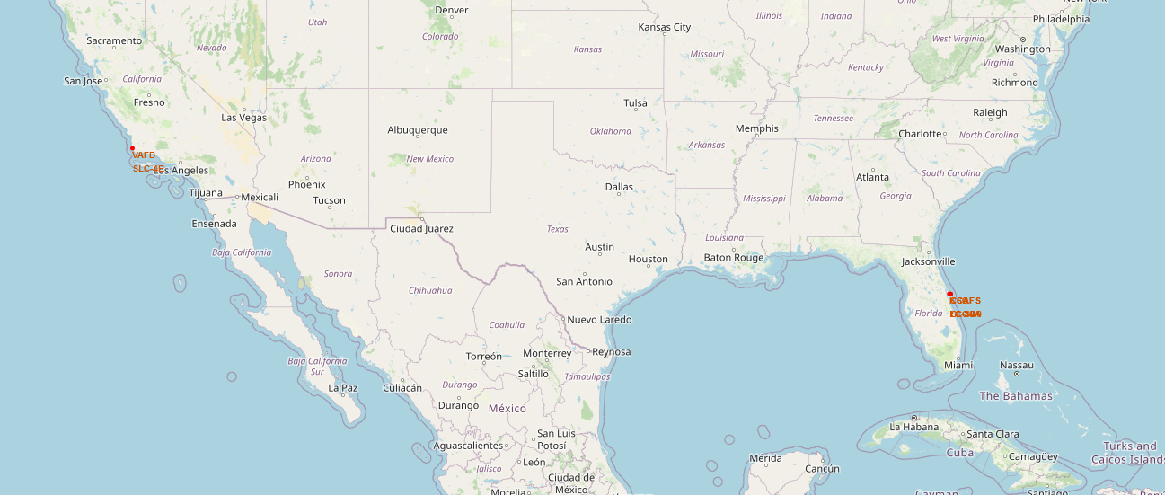
All launch sites on a map

Slide 35
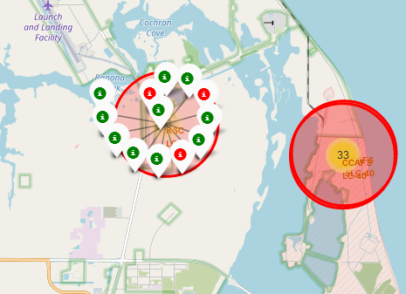
The success/failed launches for each site on the map

Slide 36
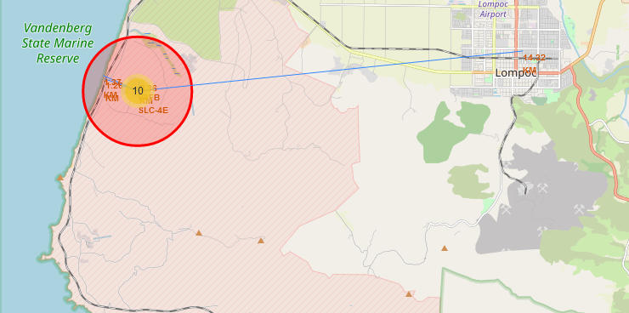
The distances between a launch site to its proximities

Slide 37
Dashboards

Slide 38
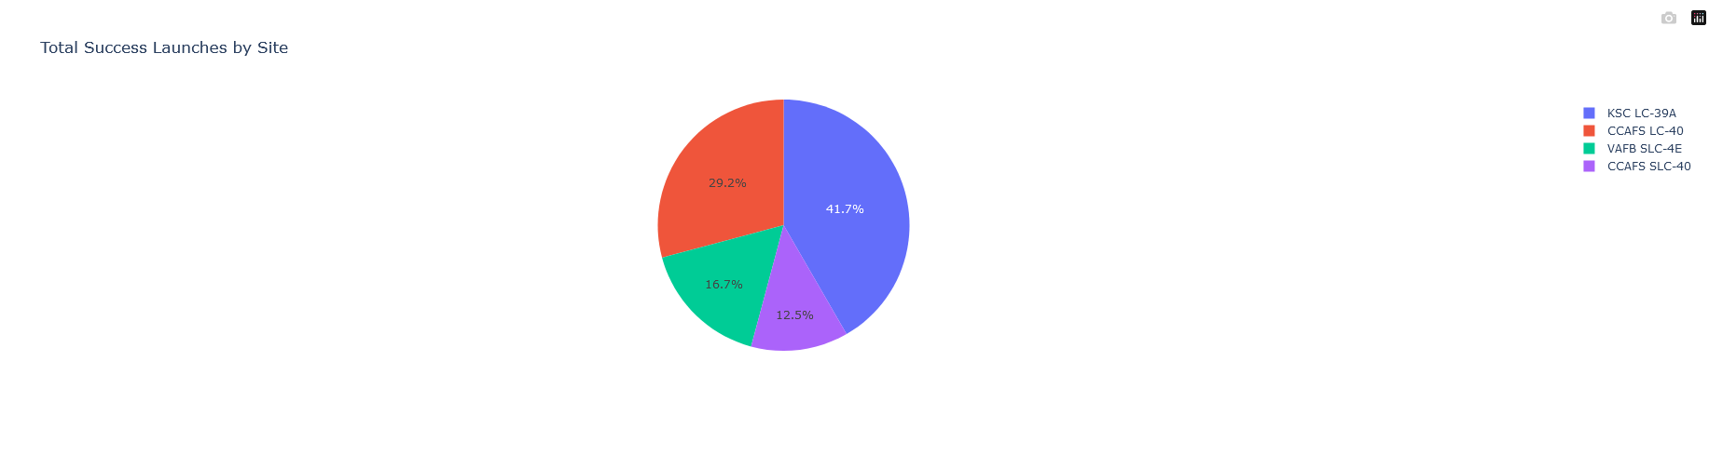
Launch success count for all sites
The pie chart shows that from all the sites, KSC LC-39A has the most successful launches.

Slide 39
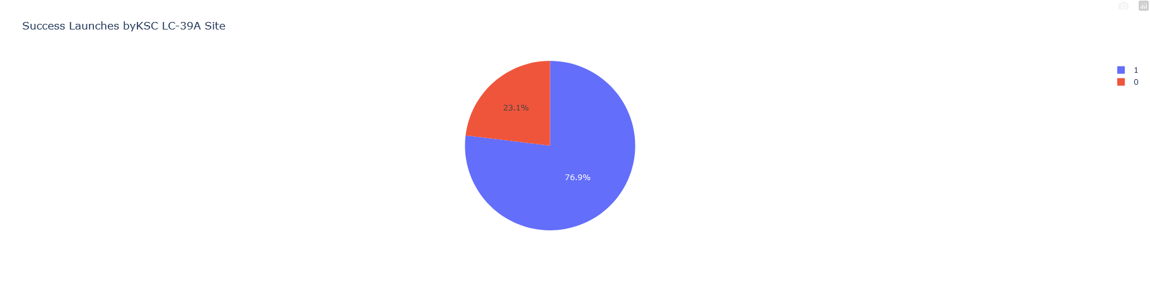
The launch site with highest launch success ratio
KSC LC-39A has 76,9% success rate.

Slide 40
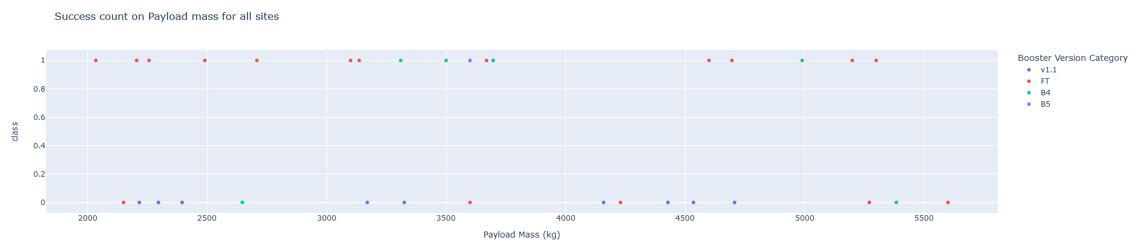
Payload vs. Launch Outcome scatter plot for all sites
The best results are located between 2000 and 5000 payload mass(kg).

Slide 41
Machine Learning Algorithms

Slide 42
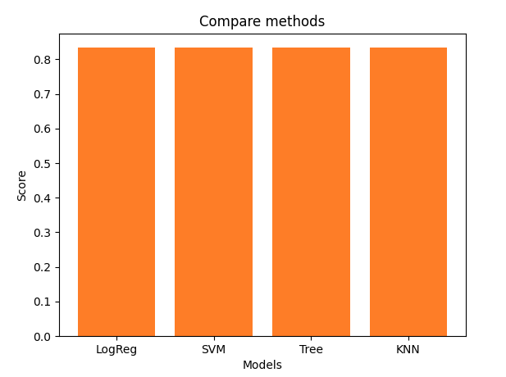
Classification Accuracy
The standard evaluation method(‘model’.score()) of GridSearchCV is used. It showed that all 4 classification models can be used on this type of data.

Slide 43
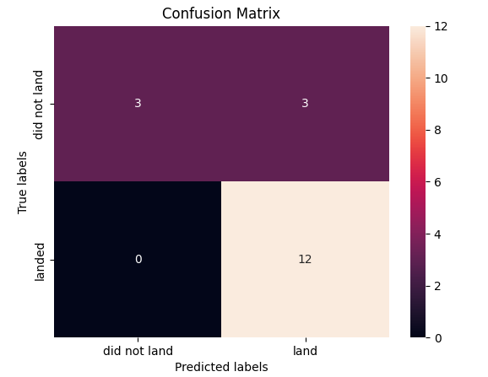
Confusion Matrix
We can see the distinction between the different classes on the confusion matrix. We can see that the main problem is false positives.

Slide 44
Conclusions
The ES-L1, GEO, HEO,SSO has 100% success rate.
The success rate since 2013 kept increasing till 2020.
CCAFS SLC 40 is good choice for extra heavy rockets(>10000)
KSC LC 39A has 100% success rate for payload mass under 5000
Most of the launch sites are close to the equator and all are very close to the coast.
All 4 predictive models have the same results on the test set. So we can use any algorithm for new inputs.

Slide 45
Appendix
https://api.spacexdata.com/v4/rockets/ - SpaceX api where stored data about launches.
https://en.wikipedia.org/wiki/List_of_Falcon_9_and_Falcon_Heavy_launches?utm_id=NA-SkillsNetwork-Channel-SkillsNetworkCoursesIBMDS0321ENSkillsNetwork26802033-2022-01-01 - SpaceX api where stored data about only Falcon 9 launches.

